Slide 1

MindBalance.
By Aliza Raza
RAZ22521479

Slide 2
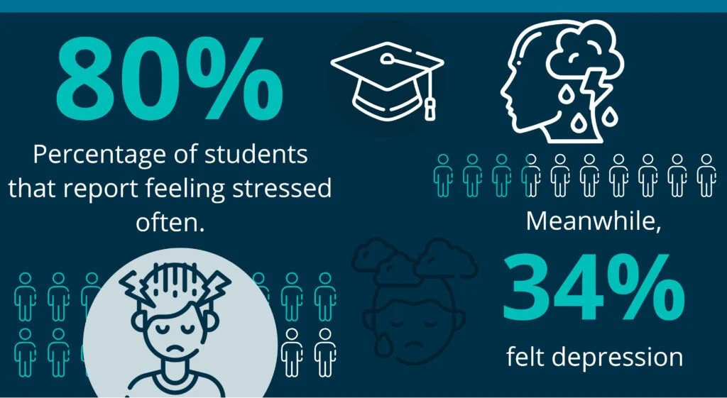


Problem? Importance? Beneficiaries?
Importance:
Neglected stress and anxiety can have an impact on students' academic performance, social interactions and general well-being, thus addressing this issue is essential. Burnout or even more severe mental health issues may result from these difficulties if prompt and easily accessible support is not obtained.
Beneficiaries:
College and university students in need of immediate, easily accessible and individually personalised mental health care. By encouraging a healthier learning environment and better student results, educators and institutions will gain additional benefits.
Problem:
Due to social pressures, academic stress and the constraints of juggling personal and academic obligations, many students struggle with their mental health. Despite this, several individuals do not have easy access to individualised support that can aid in healthy emotional management.

Slide 3

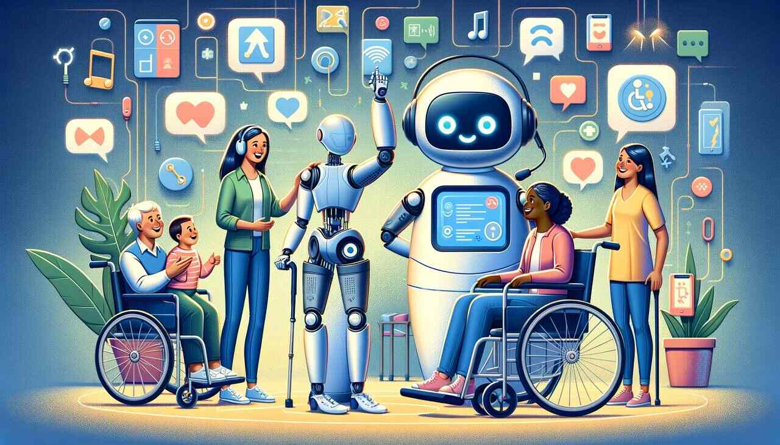
The Project Aims and Objectives
Objective 1: Focussing on typical student pressures, to investigate practical mental health techniques and incorporate them into the app's recommendation engine by November 2024.
Primary Aim:
By offering individualised mental health advice and insights, we hope to improve students' emotional wellbeing and assist them in better coping with social and academic pressures.
Objective 2: To create, by February 2025, a mobile application driven by AI that evaluates student input and provides immediate, student-centered emotional assistance.
Objective 3: By March 2025, a 80% user satisfaction rating is to be attained through the use of user testing and feedback loops with student users.

Slide 4




Indicative Resources and Technologies Required
Human Resources:
Experts in mental health, mobile app developers, AI/ML professionals and UX/UI designers with an emphasis on student user experience.
Physical Resources:
Testing tools (such as cellphones and tablets) and focus groups for gathering student input.
Technological Resources:
Python for machine learning models, cloud services like AWS or Firebase and Flutter or React Native for app development.
Financial Resources:
Set aside money for testing, development, hosting and student community-focused marketing.

Slide 5
Project Timeline and Key Milestones
Milestone | Description | Due Date | Duration
Milestone 01: Project Proposal Survey & Presentation | Submit proposal outlining the project scope | 28th Oct 2024 | 1 day
Research & Planning | Conduct research on student mental health needs | Nov 2024 | 1 month
Milestone 02: Mid-Project Review | Present progress and gather feedback | 16th Dec 2024 | 2 weeks
Development Phase 1 | Develop core app features | Dec 2024 - Jan 2025 | 2 months
Prototype Testing | Initial user testing with student focus groups | Early Feb 2025 | 2 weeks
Development Phase 2 | Refine app based on feedback, add advanced features | Mid Feb - Early March 2025 | 3 weeks
Final Testing & Launch Preparation | Finalise testing, bug fixes and deployment preparation | Mid March 2025 | 1 week
Milestone 03: Exhibition & Artefact Demonstration | Showcase app to peers, educators and stakeholders | 24th March 2025 | 9 days
Milestone 04: Project Report Submission | Submit final project report | 31st March 2025 | 1 week
Launch | Official release of app | 31st March 2025 | n/a

